Slide 1
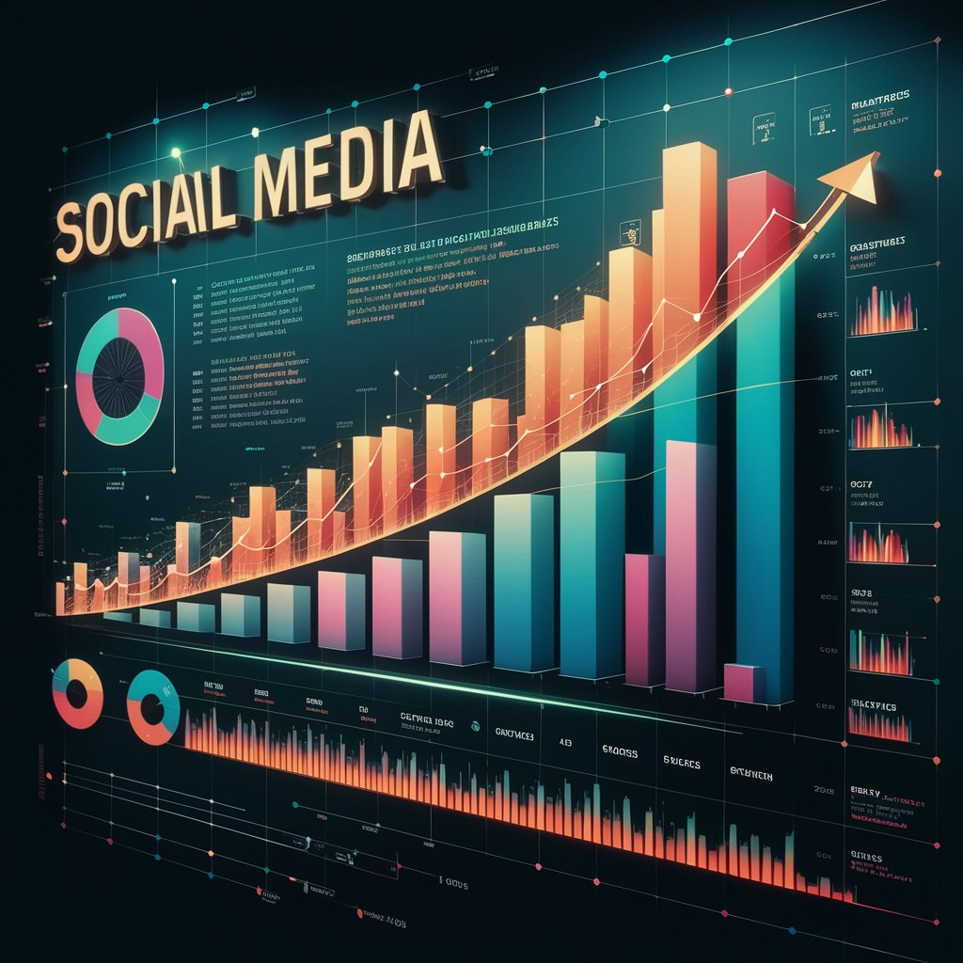
Social Media Project
Presented by : Shyam kumar Kapuleneni

Slide 2
Problem Statement
Modern social media platforms generate vast amounts of user interaction data, but deriving actionable insights from this data remains a challenge. This project analyses user activity, engagement patterns, and content performance to identify high-value users, trending hashtags, and optimal posting strategies. The goal is to leverage data-driven insights to improve user engagement, personalize content, optimize marketing campaigns, and support strategic decision-making for platform growth.

Slide 3
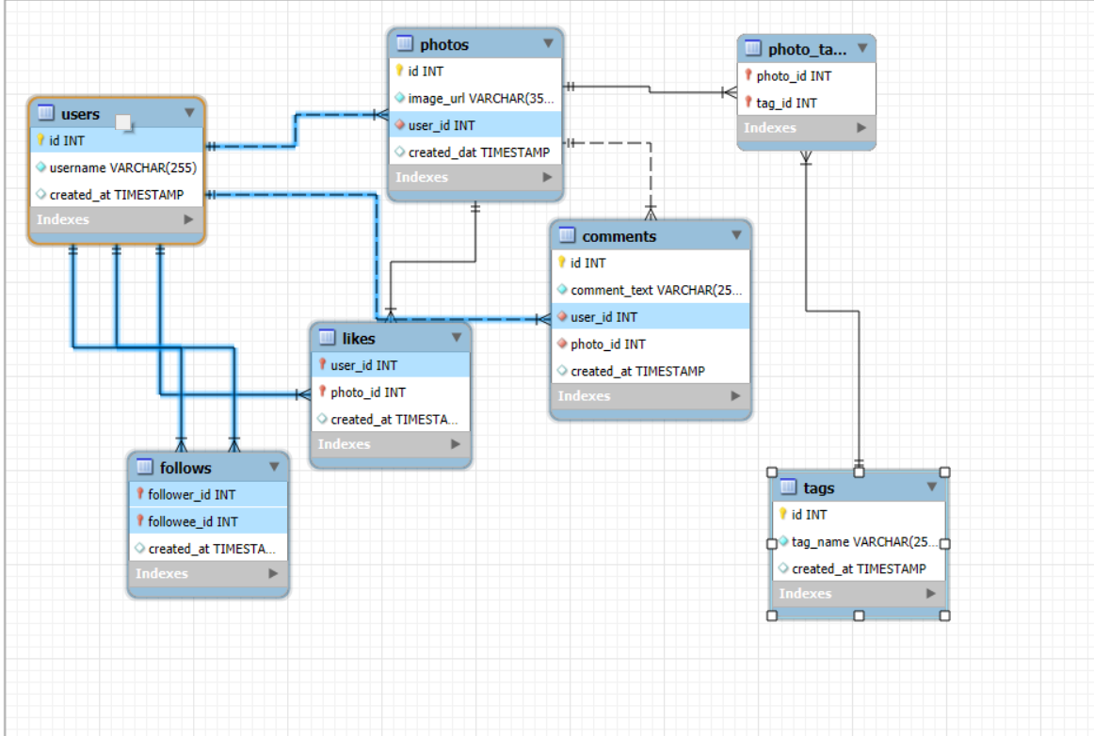
Database Schema

Slide 4
Data Attributes
Comments Table
Comment ID: Unique comment identifier
Comment Text: Content of the comment
User ID: Comment author (FK)
Photo ID: Associated post (FK)
Created At: Comment timestamp
Follows Table
Follower ID: User who follows (FK)
Followee ID: User being followed (FK)
Created At: Follow date
Tags Table
Tag ID: Unique hashtag identifier
Tag Name: Hashtag text
Created At: Tag creation timestamp
Photo_Tags Table
Photo ID: Post identifier (FK)
Tag ID: Associated hashtag (FK)
Users Table
User ID: Unique identifier for each user
Username: Display name of the user
Created At: Account creation timestamp
Photos Table
Photo ID: Unique identifier for each post
Image URL: Link to the uploaded image
User ID: Creator of the post (FK)
Created At: Post upload timestamp
Likes Table
User ID: User who liked the post (FK)
Photo ID: Liked post identifier (FK)
Created At: Like timestamp

Slide 5
Methodology
Data Collection:
Extracted structured data from social media tables including users, posts (photos), likes, comments, followers, tags, and hashtags.
Data Modeling & Validation:
Analyzed schema relationships (users–posts–engagement–hashtags) and ensured data integrity using primary keys, foreign keys, and constraints.
Data Preparation:
Cleaned and aggregated data using SQL to compute key metrics such as total posts, likes, comments, followers, and engagement rates.
Exploratory Data Analysis (EDA):
Used SQL queries, CTEs, and window functions to identify user activity patterns, top hashtags, influencer candidates, and inactive users.

Slide 6
User Segmentation:
Classified users into segments (power creators, micro-influencers, active engagers, passive consumers) based on behavior and engagement.
Insight Generation:
Derived actionable insights for content strategy, influencer marketing, re-engagement campaigns, and ad optimization.
Visualization & Reporting:
Presented findings using charts and summarized insights in a presentation-friendly format for business decision-making.

Slide 7
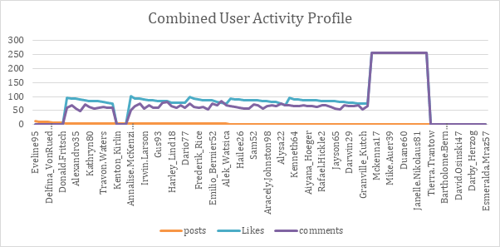
Combined User Activity Profile
A small group of users generates very high likes and comments despite having zero posts, indicating heavy engagement-only (consumer) behavior.
Top content creators (5–12 posts) show consistently high engagement, making them core contributors to platform activity.
Many users with low posting frequency (1–2 posts) still receive strong engagement, suggesting content quality matters more than volume.

Slide 8
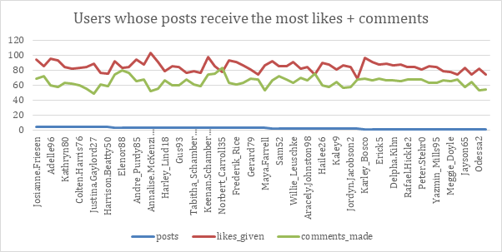
Top Users by Post Engagement (Likes & Comments)
A small group of users consistently receives high likes and comments despite posting fewer posts, indicating strong content quality over quantity.
Likes are generally higher than comments, suggesting users prefer quick interactions rather than deeper engagement.
Engagement levels remain relatively stable across top users, showing a mature and loyal audience base.
These users are strong candidates for featured content, influencer partnerships, or brand collaborations due to sustained engagement.

Slide 9
Consistently Active Users
A small group of users consistently drives a disproportionately high number of likes and comments.
Engagement levels remain stable across time for these users, indicating strong platform loyalty.
These users contribute significantly to overall interactions despite not always posting the most content.
Ideal candidates for retention programs, early feature access, and brand ambassador initiatives.

Slide 10
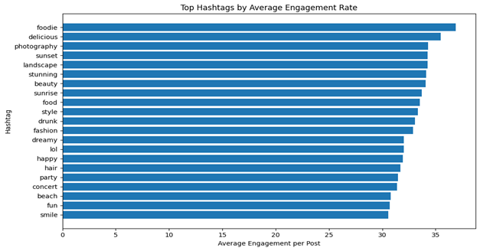
Top Hashtags by Average Engagement Rate
Food-related hashtags such as #foodie and #delicious achieve the highest average engagement, indicating strong audience interest in food content.
Visual-centric hashtags like #photography, #sunset, #landscape, and #stunning consistently perform well, highlighting the importance of high-quality visuals.
Lifestyle and emotion-based hashtags (#happy, #smile, #fun, #party) show steady engagement, making them suitable for broad reach campaigns.
Lower-ranked but still effective hashtags (e.g., #beach, #concert) can be combined with top performers to balance reach and relevance.

Slide 11
Likes consistently exceed comments across users, indicating that liking is the primary mode of engagement.
Users with even a small number of posts can generate high likes and comments, showing content quality matters more than volume.
Engagement levels are relatively stable across most active users, suggesting a healthy and balanced interaction ecosystem.
A few users stand out with peak likes and comments, making them strong candidates for influencer or ambassador programs.

Slide 12
High-Volume Engagement Hashtags
#smile generates the highest engagement, indicating it is the most widely interacted hashtag across users. As its Average engagement is low.
#beach and #party also show strong engagement volumes, suggesting lifestyle and social themes resonate well.
#fun maintains consistent engagement, making it a reliable hashtag for general content reach.
#concert has comparatively lower engagement, indicating a more niche or event-specific audience.

Slide 13
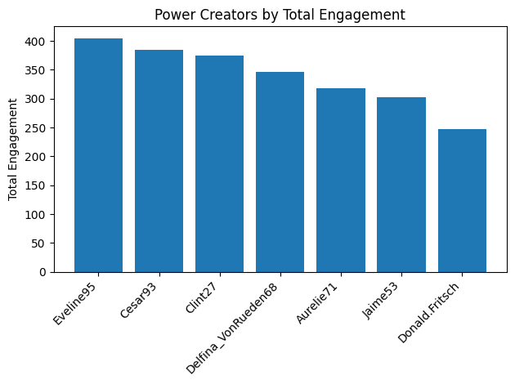
Power Creators By Total Engagement
Eveline95 leads overall engagement, making them the strongest power creator and a prime candidate for high-visibility campaigns.
A small group of users (Eveline95, Cesar93, Clint27) contributes a disproportionately high share of total engagement, indicating a strong creator concentration effect.
Consistent engagement across the top creators suggests loyal audiences rather than one-time viral spikes.
These users are ideal for influencer partnerships, brand collaborations, and early feature rollouts due to their proven engagement impact.

Slide 14
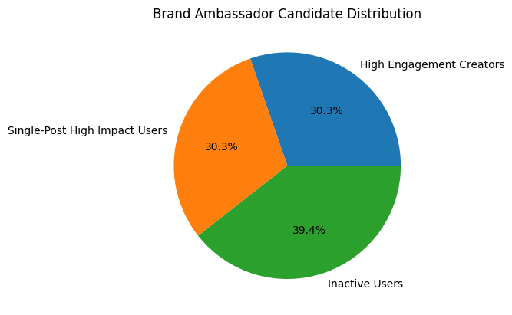
Brand Ambassador Candidate Distribution
Inactive Users form the largest segment (~39%), indicating a significant opportunity for re-engagement campaigns before considering ambassador roles.
High Engagement Creators (~30%) are strong candidates for brand ambassadors due to consistent interaction and influence.
Single-Post High Impact Users (~30%) show viral potential and can be leveraged for event-based or short-term campaigns.
A balanced ambassador strategy should combine consistent creators with high-impact users while nurturing inactive users to expand the future talent pool.

Slide 15
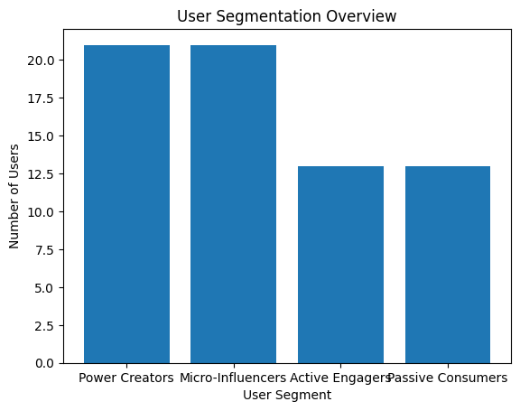
User Segmentation Overview
Power Creators & Micro-Influencers form the largest segments, driving most platform engagement.
Active Engagers represent a strong interaction base with lower content creation.
Passive Consumers are sizable, indicating growth potential through activation strategies.
Clear segmentation enables targeted content, ads, and creator partnerships.

Slide 16
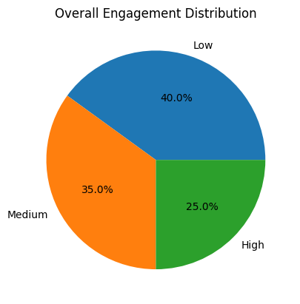
Overall Engagement Distribution
40% of users show low engagement, representing the largest improvement opportunity
35% fall into medium engagement, ideal targets for nudging toward higher activity
25% are highly engaged users, driving a disproportionate share of platform value
Focus strategy: convert medium → high while re-activating low-engagement users

Slide 17
Summary of Findings
A small group of power creators and micro-influencers drive a disproportionate share of total engagement, making them ideal for influencer and brand collaborations.
Hashtag selection strongly impacts engagement, with lifestyle and visual tags (e.g., foodie, photography, sunset, beach) consistently outperforming others.
User activity follows a clear segmentation pattern: active creators, engaged consumers, passive users, and inactive users—each requiring different engagement strategies.
Single-post high-impact users demonstrate that quality content can outperform posting frequency, highlighting opportunities for curated promotions.
A significant portion of users fall into low to medium engagement categories, indicating strong potential for re-engagement through targeted campaigns and personalized content.
Engagement trends suggest that content relevance and timing matter more than volume, guiding future content creation and ad optimization strategies.

Slide 18
Recommendations
Prioritize high-engagement creators for influencer partnerships and brand ambassador programs to maximize reach and authenticity.
Leverage top-performing hashtags (e.g., smile, foodie, beach) in campaigns to boost visibility and engagement.
Re-engage inactive and passive users through personalized notifications, challenges, and content prompts.
Enable personalized content feeds based on user activity segments (power creators, micro-influencers, passive users).

Slide 19
Thank You

